Slide 2
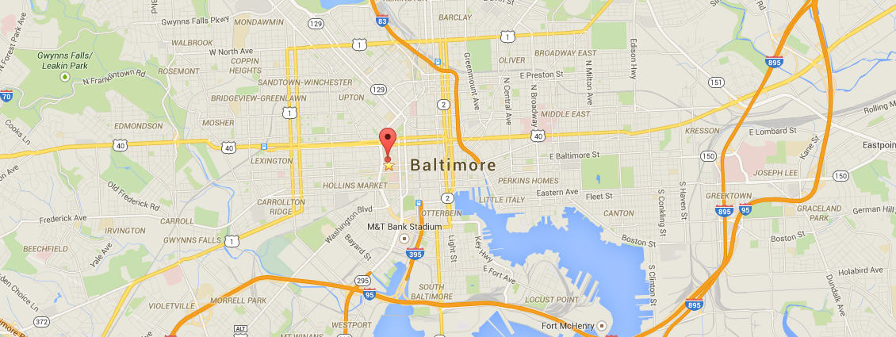


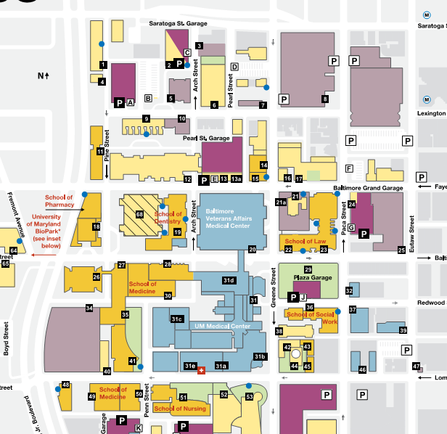


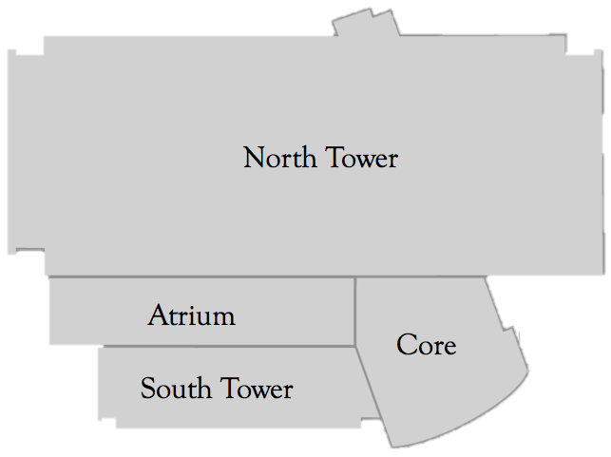







Building Name Health Sciences Facility III
Building Location Baltimore, MD
Size 435,000 GSF
Number of Stories 11 above grade, 2 below
Construction Date July 2013-September 2017
Construction Cost $206 Million
Delivery Method CM at Risk
Project Team

Slide 3
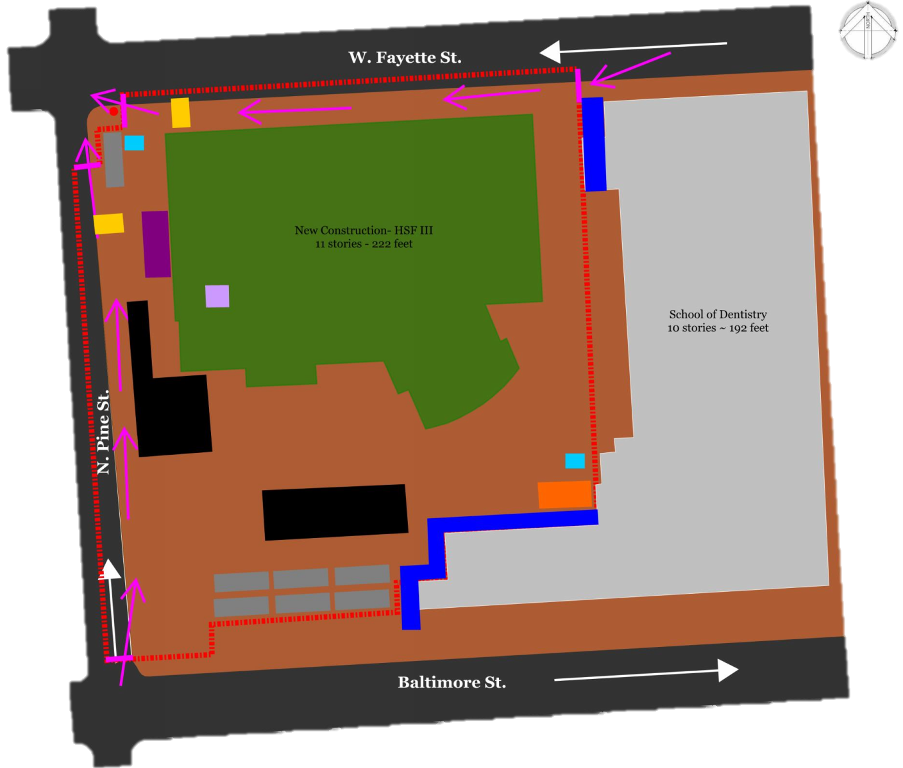
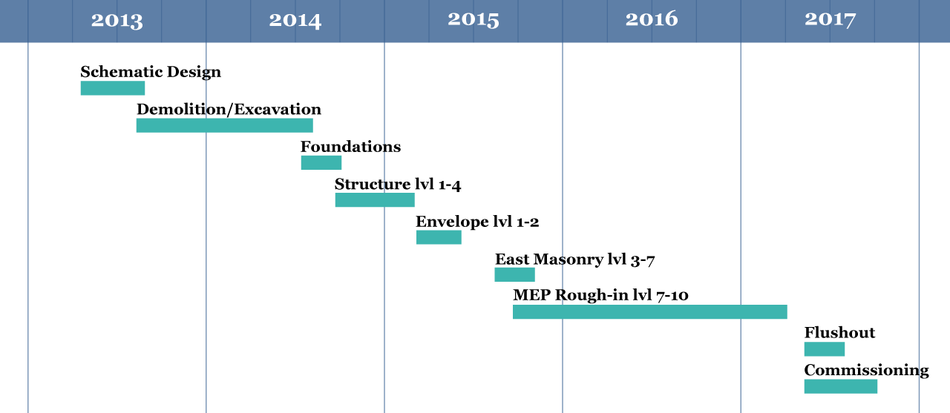
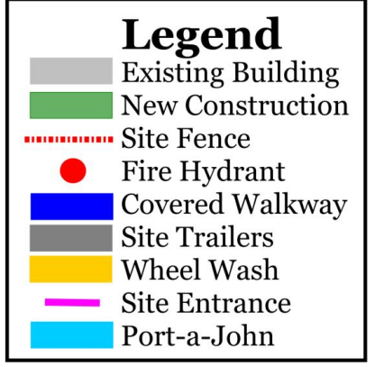
Construction Cost
System | Amount
Demolition/Excavation | $7,616,000
Structure | $21,297,000
Envelope | $34,726,000
Mechanical/Plumbing | $62,903,000
Electrical | $32,357,000
Fire Protection | $1,965,000
Sitework | $2,672,800
Other | $42,956,200
General Conditions | $10,130,300
Total | $ 206,493,000
|Site Logistics
|Critical Path

Slide 4
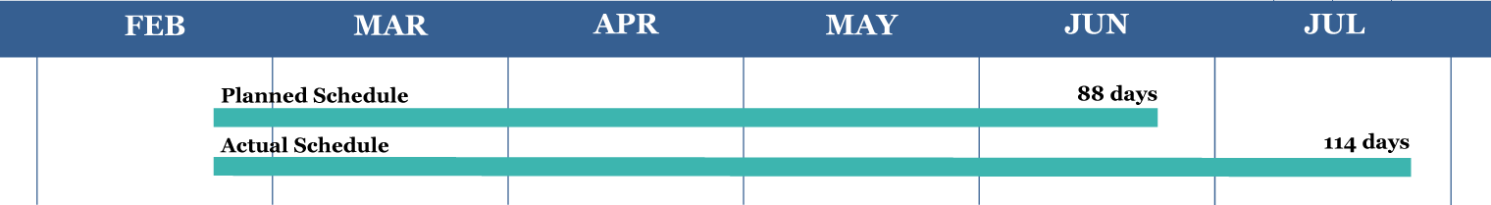
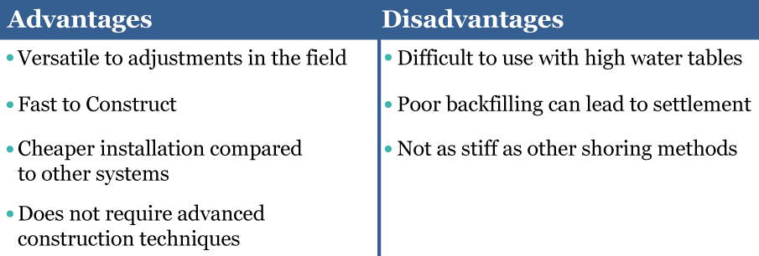
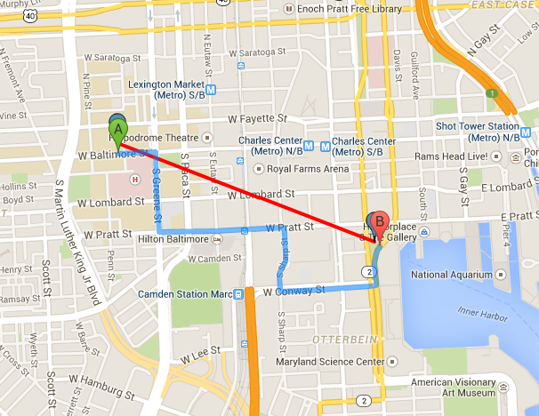
Analysis 1 | Shoring System
|Pile and Lagging
Shoring | $1,480,000
Dewatering Issues | $650,000
New Total | $2,130,000
.712 miles

Slide 5
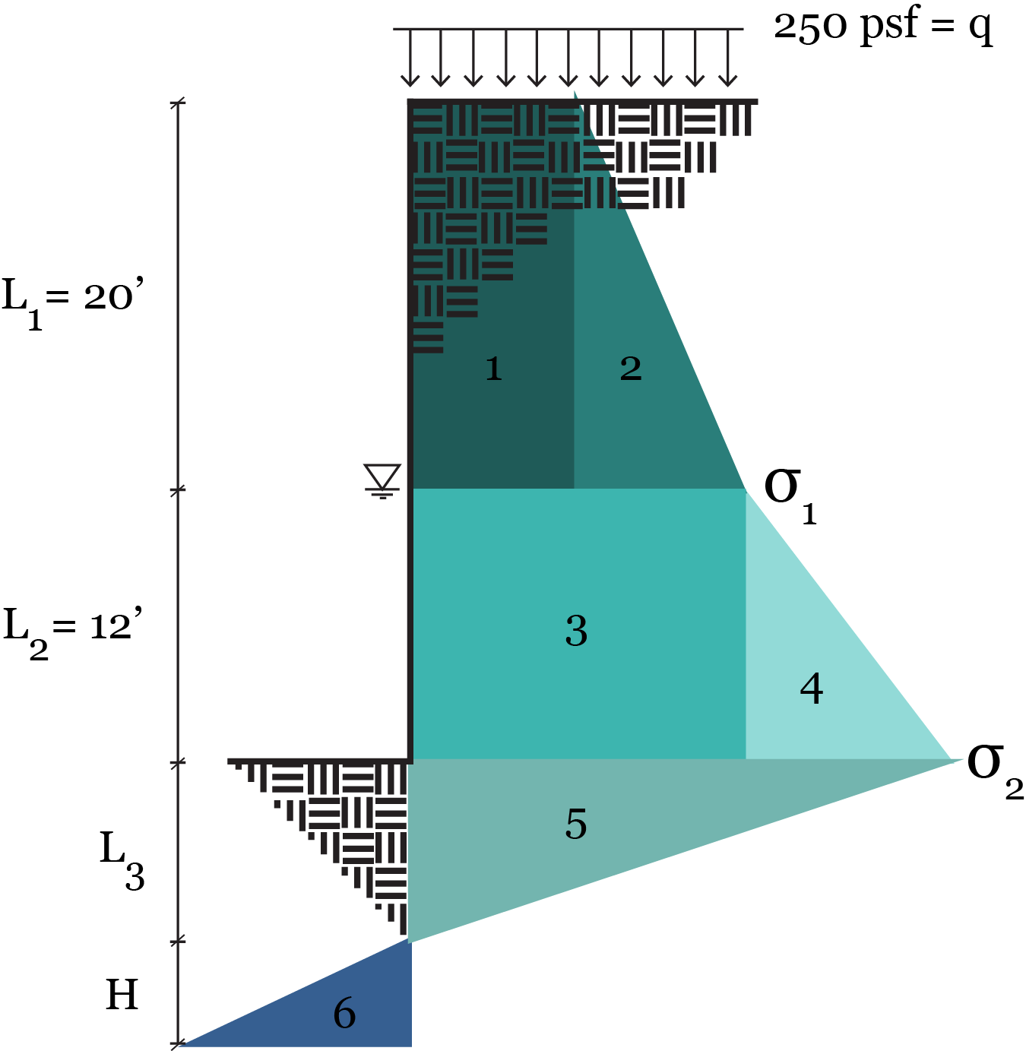
Assumed Values
Soil Property | Amt | Unit
Water Table | 20 | ft
Angle of Friction, φ | 35 | Degrees (°)
Moist Unit Weight, γ | 125 | pcf
Sat Unit Weight, γ_{SAT} | 145 | pcf
Construction surcharge, q | 250 | psf
Allowable bearing, q_{a} | 5000 | psi
Soil Type | SM | --
Calculated Values
Property | Amt | Unit
γ’=γ_{SAT} -γ_{w} | 82.6 | pcf
k_{a} | .271
k_{p} | 3.69

Slide 6
Assumed Values
Soil Property | Amt | Unit
Water Table | 20 | ft
Angle of Friction, φ | 35 | Degrees (°)
Moist Unit Weight, γ | 125 | pcf
Sat Unit Weight, γ_{SAT} | 145 | pcf
Construction surcharge, q | 250 | psf
Allowable bearing, q_{a} | 5000 | psi
Soil Type | SM | --
P₁= 1.355 k
P₂= 6.775 k
P₃= 8.943 k
P₄=6.105 k
Calculated Values
Property | Amt | Unit
γ’=γ_{SAT} -γ_{w} | 82.6 | pcf
k_{a} | .271
k_{p} | 3.69
L₃= 6.24 ft
P₅= 5.501 k

Slide 7
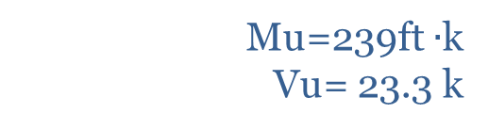
Assumed Values
Without Tiebacks
Soil Property | Amt | Unit
Water Table | 20 | ft
Angle of Friction, φ | 35 | Degrees (°)
Moist Unit Weight, γ | 125 | pcf
Sat Unit Weight, γ_{SAT} | 145 | pcf
Construction surcharge, q | 250 | psf
Allowable bearing, q_{a} | 5000 | psi
Soil Type | SM | --
H= 24.4 ft
Total height= 62.64 ft
P₁= 1.355 k
P₂= 6.775 k
With Tiebacks
P₃= 8.943 k
H= 5.5 ft
Total height= 44 ft
Tieback Force= 24k/ft
P₄=6.105 k
Calculated Values
Shear and Moment
Property | Amt | Unit
γ’=γ_{SAT} -γ_{w} | 82.6 | pcf
k_{a} | .271
k_{p} | 3.69
L₃= 6.24 ft
P₅= 5.501 k
Mu=239ft $∙$k
Vu= 23.3 k

Slide 8
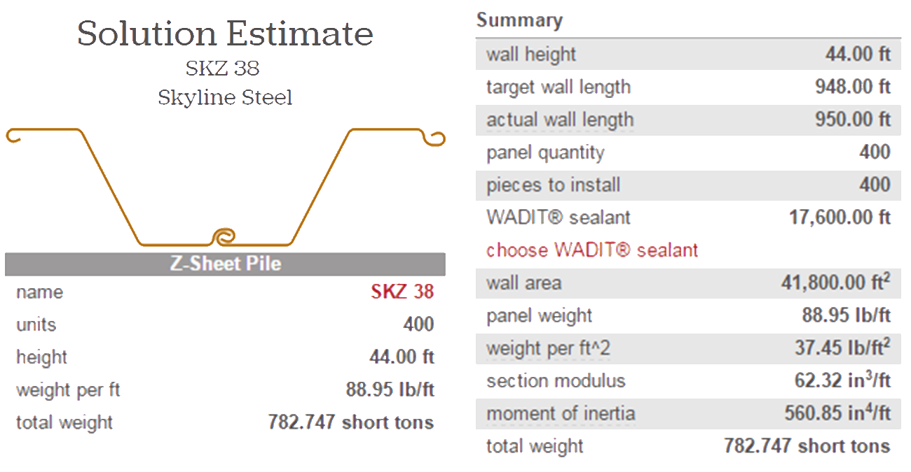
|Sheet Piles

Slide 9
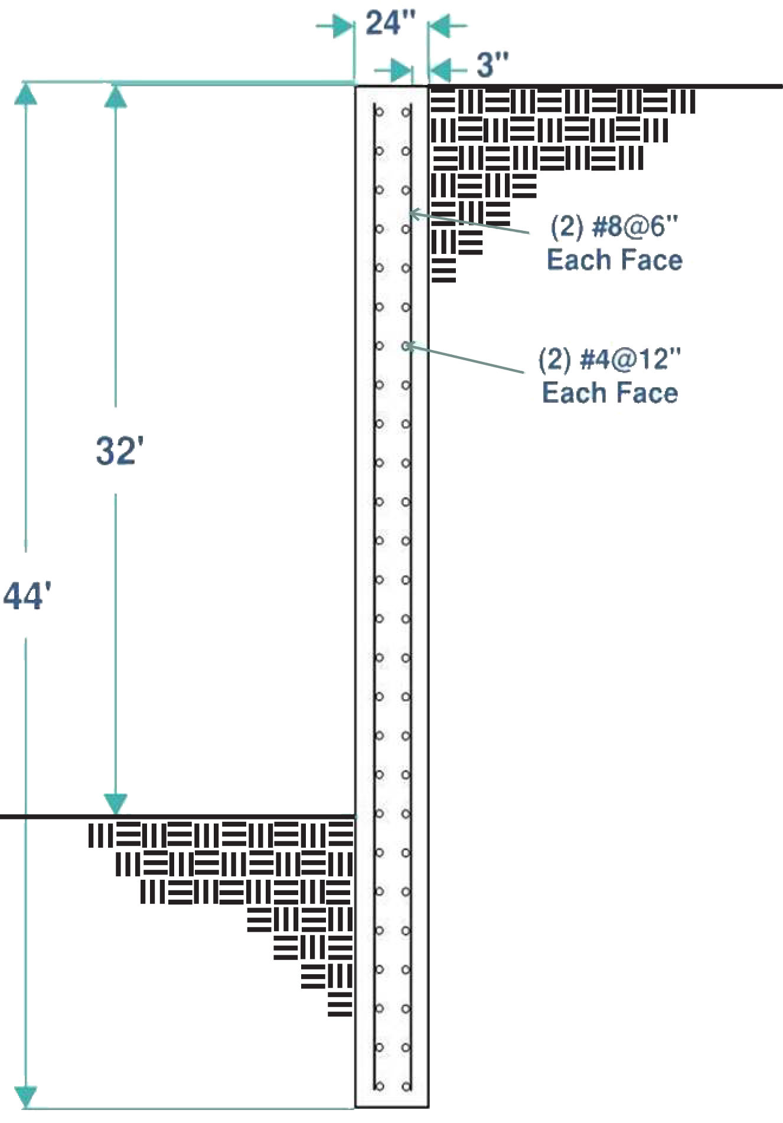
|Sheet Piles
|Slurry Wall

Slide 10
Comparison Matrix
|Recommendations
|Cost
Sheet Piles Recommended ✔
Shoring System | Price
Pile and Lagging | $2,130,000
Sheet Piles | $1,640,000
Slurry Wall | $3,029,810
 | Pile and Lagging | Sheet Piles | Slurry Wall
Availability | ✔ | ✔ | ✔
Constructability |  | ✔
Cost | ✔ | ✔
Schedule | ✔ | ✔
|Schedule
114 Days
90 Days
363 Days

Slide 11
Analysis 2 | Motivation
?
Question: What are the drivers of motivation and how does that correlate with team performance?
Audience: Construction Managers
Method: Literature review and industry survey

Slide 12
Survey Results
|Drivers of Motivation
A respectable leader | Negative consequences
Formal recognition | Team reputation
Promotional opportunities | Negative feedback
Time off | An unmotivated team leader
A challenging project | The team
Money | When believe in the cause
A complex project
Not at All | Very Little | Somewhat | Significantly | Very Significantly

Slide 13
Survey Results
|Drivers of Motivation
Driver | % Significant | Driver | % Insignificant
Believe in Cause | 100 | Unmotivated Team Member | 60
Respectable Leader | 97 | Negative Consequences | 43
A Challenging Project | 83 | Negative Feedback | 27
Team reputation | 80 | Time Off | 20
Assuming Leadership Position | 77 | Formal Recognition | 7
A Complex Project | 73 | Promotional Opportunities | 7
The Team | 63 | Team Reputation | 7
Promotional Opportunities | 60 | Money | 3
Money | 57 | A Complex Project | 3
Time Off | 53 | The Team | 3
Formal Recognition | 50 | Respectable Leader | 0
Negative Consequences | 37 | A Challenging Project | 0
Negative Feedback | 27 | Assuming Leadership Position | 0
Unmotivated Team Member | 10 | Believe in Cause | 0
A respectable leader | Negative consequences
Formal recognition | Team reputation
Promotional opportunities | Negative feedback
Time off | An unmotivated team leader
A challenging project | The team
Money | When believe in the cause
A complex project
Not at All | Very Little | Somewhat | Significantly | Very Significantly

Slide 14
Survey Results
|Negative Correlation
|Positive Correlation
Driver #1 | Driver #2 | Degree of Correlation
A complex project | A challenging project | .70
When believe in the cause | The team | .58
The team | Motivated leader influences team performance | .54
Formal recognition | Promotional opportunities | .51
Promotional opportunities | Time off | .45
Driver #1 | Driver #2 | Degree of Correlation
Money | Degree motivation related to team performance | -.44
A complex project | Motivated leader influences team performance | -.43
Money | Assuming a leadership position | -.40
A complex project | Unmotivated leader influences team performance | -.39
Money | Motivated leaders influences team performance | -.38

Slide 15
Survey Results
|Age Correlation

Slide 16
Survey Results
|Open-Ended Questions
What do you think is the most effective way to motivate your team?
Communication
Family community
Good leadership
Positive recognition
A good attitude
Be an example
Clear goals
Understand the individuals on the team

Slide 17
Survey Results
|Open-Ended Questions
What do you think is the most effective way to motivate your team?
How does conflict affect motivation or team performance?
Communication
Family community
Good leadership
Positive recognition
A good attitude
Be an example
Clear goals
Understand the individuals on the team
“
If handled well, conflict can become a rallying point for a team. Conflict has a tendency to motivate me to push harder and stake my position on the high road.
“
Humans will not want to do something that they do not feel comfortable doing or if conflict exists between people. Team performance will be affected if conflict exists because the team will not trust each other and it will hinder communication between the two parties.

Slide 18
Analysis 2 | Motivation
|Results
Two major drivers of motivation:
  Belief in the cause
  Respectable leader
Negative motivators
Age correlation
Trust and communication
Conflict and team performance

Slide 19
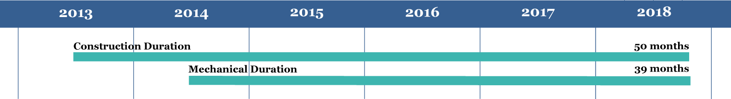
Analysis 3 | Cash Flow
Fiscal Year | Funding (million)
FY 2014 | $18
FY 2015 | $59
FY 2016 | $91.5
FY 2017 | $53
FY 2018 | $9.5
Total | $231
$63 mil
$143 mil

Slide 20
Analysis 3 | Cash Flow
Fiscal Year | Funding (million)
FY 2014 | $18
FY 2015 | $59
FY 2016 | $91.5
FY 2017 | $53
FY 2018 | $9.5
Total | $231
$63 mil
$143 mil

Slide 21
Mechanical Review of Cash Flow
|Mechanical
Review
|Original

Slide 22
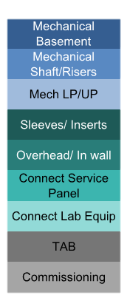
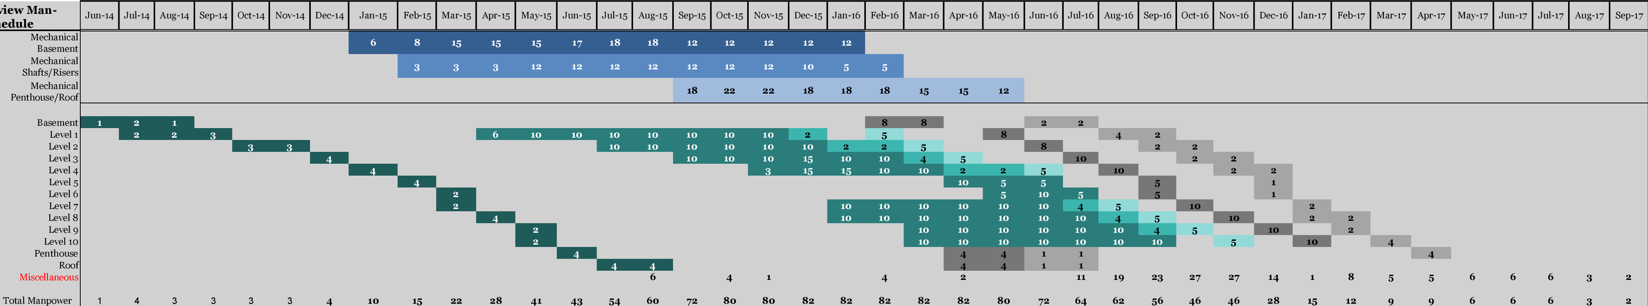
Mechanical Review
Man-loaded Schedule
Legend

Slide 23
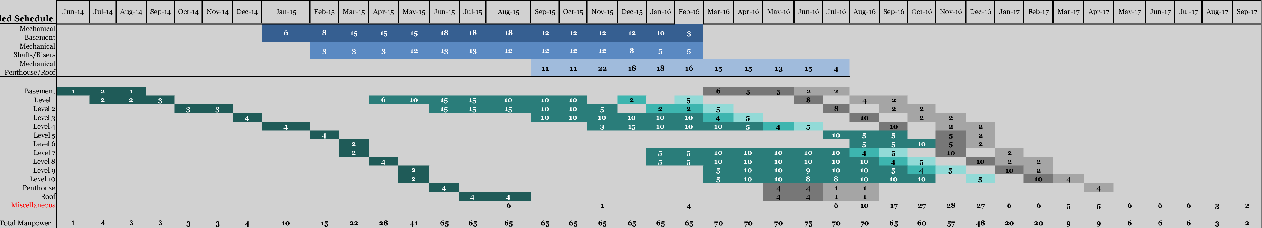
Modified Man-loaded Schedule
Legend

Slide 24
Modified Man-loaded Schedule
Fiscal Year | Funding | Mechanical Review Billing | Modified Billing | Difference
FY 2014 | $18,000,000 | $321,700 | $321,700 | --
FY 2015 | $59,000,000 | $10,910,600 | $11,463,500 | $552,900
FY 2016 | $91,500,000 | $39,874,100 | $37,377,100 | ($2,497,000)
FY 2017 | $53,000,000 | $13,141,800 | $15,086,200 | $1,944,500
FY 2018 | $9,500,000 | $173,900 | $174,000 | $100

Slide 25
Analysis 3 | Cash Flow

Slide 26
Analysis 3 | Cash Flow
|Recommendations
Resource Leveling Recommended ✔

Slide 27
Analysis 1 Shoring System
Sheet Piles Recommended ✔

Slide 28
Analysis 1 Shoring System
Analysis 2
Motivation
Two major drivers of motivation:
  Belief in the cause
  Respectable leader
Negative motivators
Age correlation
Trust and communication
Conflict and team performance
Sheet Piles Recommended ✔

Slide 29
Analysis 1 Shoring System
Analysis 2
Motivation
Analysis 3
Cash Flow
Two major drivers of motivation:
  Belief in the cause
  Respectable leader
Negative motivators
Age correlation
Trust and communication
Conflict and team performance
Sheet Piles Recommended ✔
Resource Leveling Recommended ✔

Slide 30
|Acknowledgements
Analysis 1 Shoring System
Analysis 2
Motivation
Analysis 3
Cash Flow
Academic
Industry
Dr. Somayeh Asadi
Dr. Rob Leicht
Kevin Parfitt
Walt Schneider
HSFIII Team
Roger Stadler
Chuck Briney
Josh Kraus
Bill Gamble
Chris Brooks
Other Industry Leaders
Jason McFadden
Two major drivers of motivation:
  Belief in the cause
  Respectable leader
Negative motivators
Age correlation
Trust and communication
Conflict and team performance
Sheet Piles Recommended ✔
Resource Leveling Recommended ✔
Special Thanks
Family and Friends
Jesus Christ

Slide 31
Questions?

Slide 32
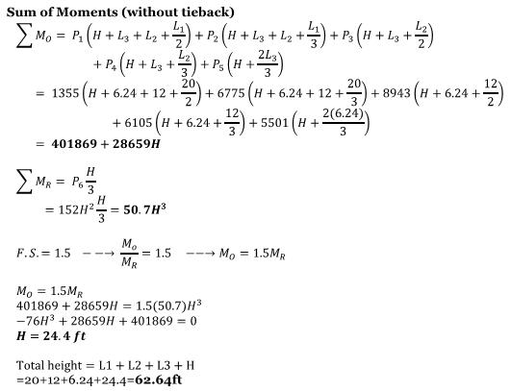
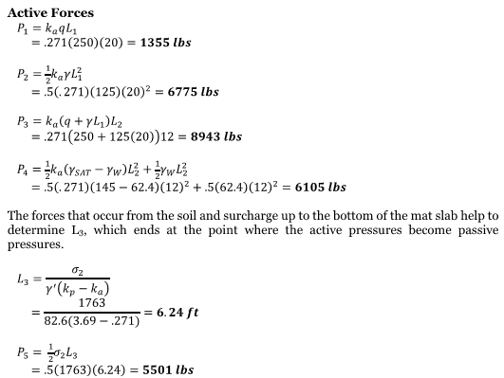

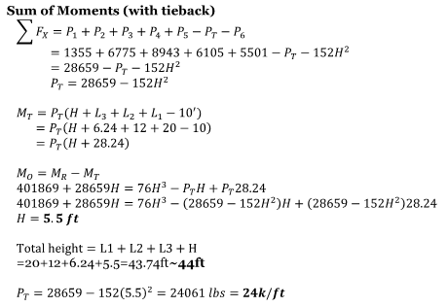
Appendix

Slide 33
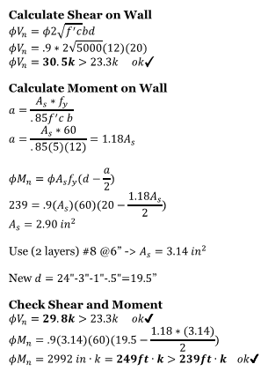
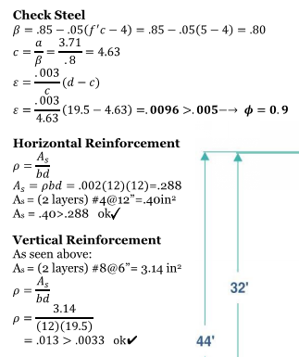

Appendix

Slide 34
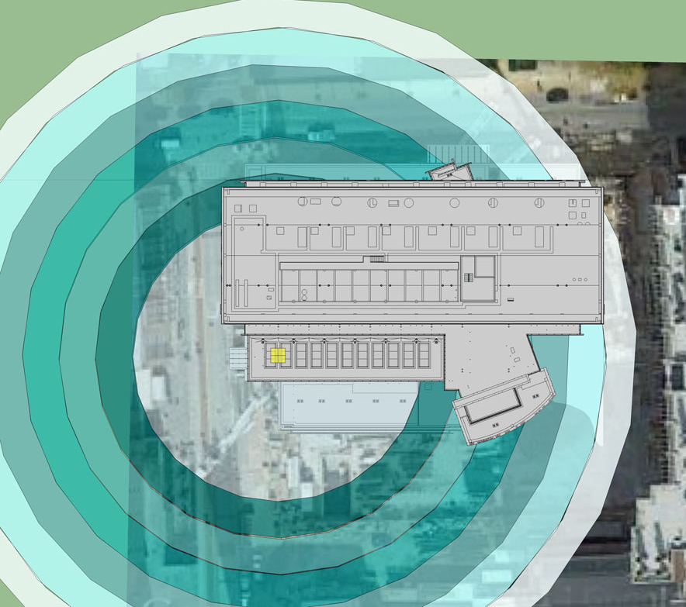
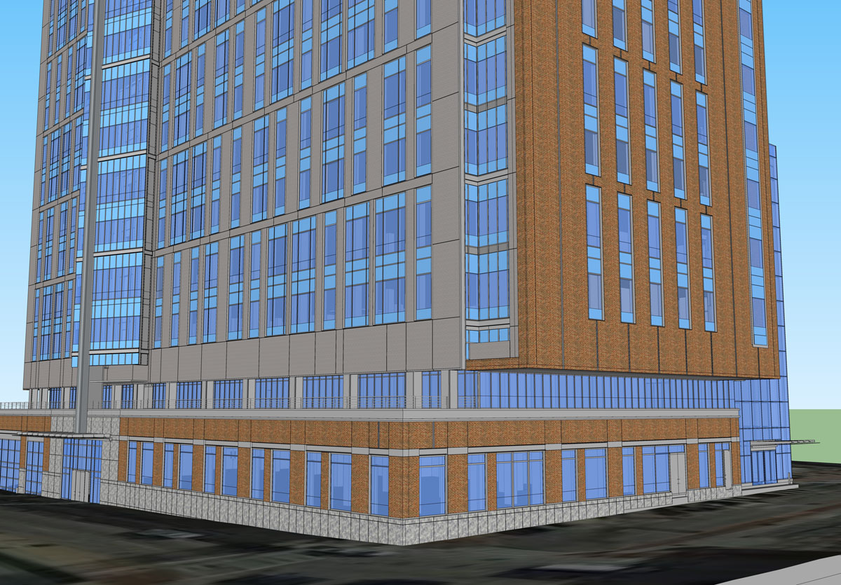
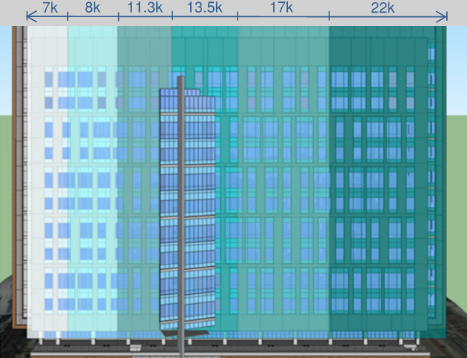
Architectural Breadth
Curtain Wall
Punch Windows
246 ft
Brick
200 ft
100 ft
Precast
Metal Panel
Granite

Slide 35
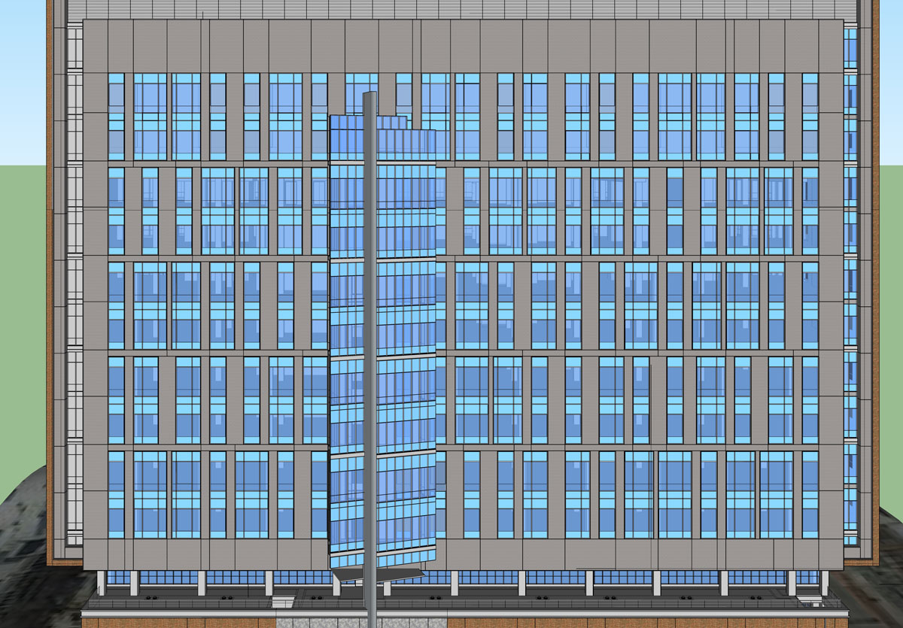
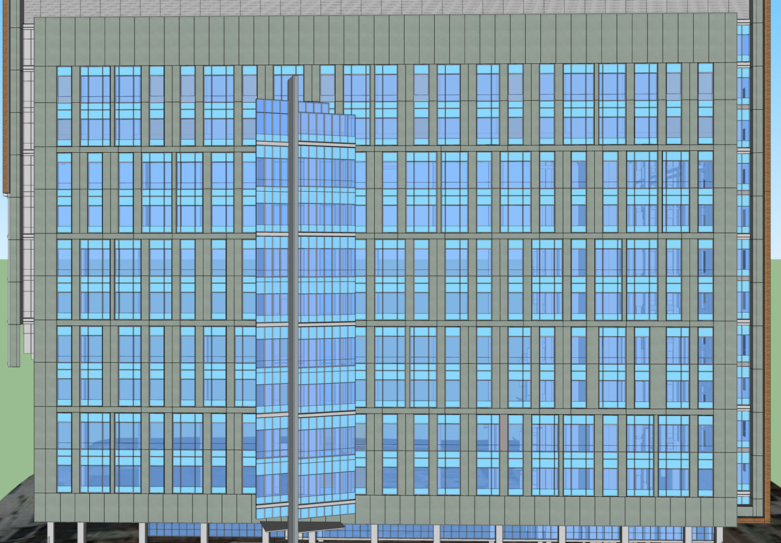
Architectural Breadth
|Modified
|Original

Slide 36
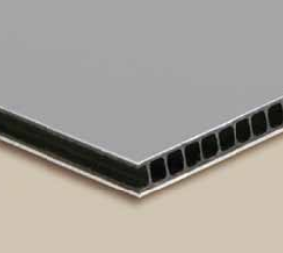
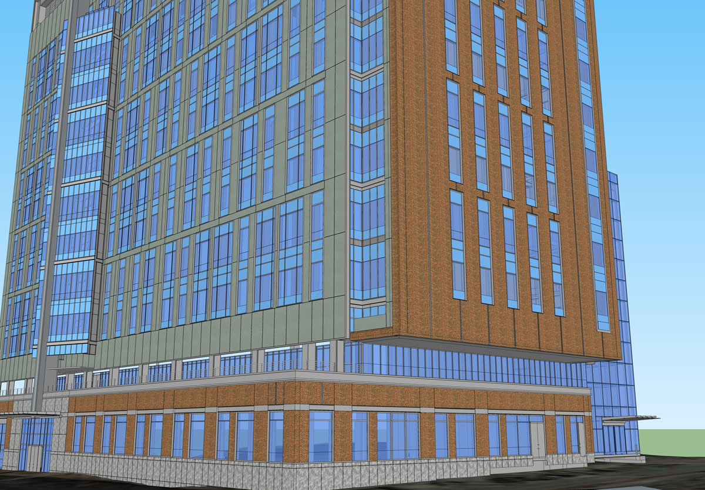

Architectural Breadth
|Recommendations
|Material Selection
Metal Panel
Recommended ✔
Omega-Lite®
Material Restrictions
60” width
Limited to certain colors
Better R-Value
Cheaper Cost/SF
Similar Panel Layout
R-Value
Precast: 1.22
Metal Panel: 2.63
Cost/SF
$103
$44

Slide 37
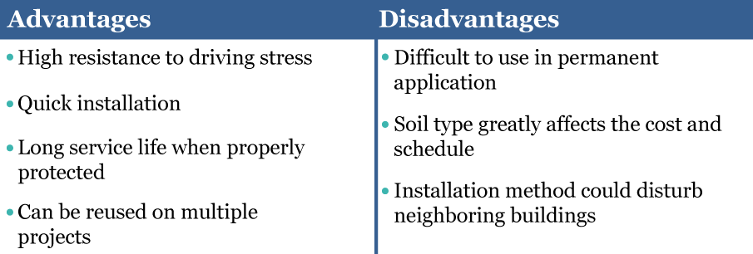
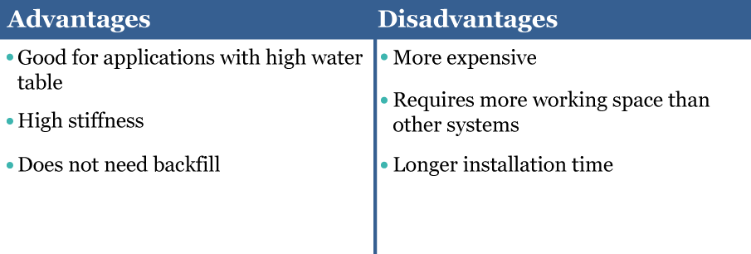
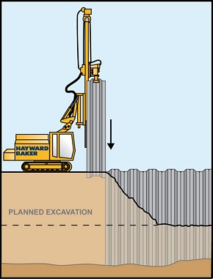
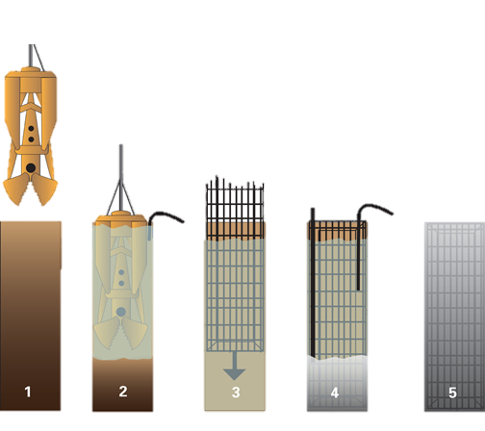
Alternative Systems
|Sheet Piles
|Slurry Wall

Slide 38
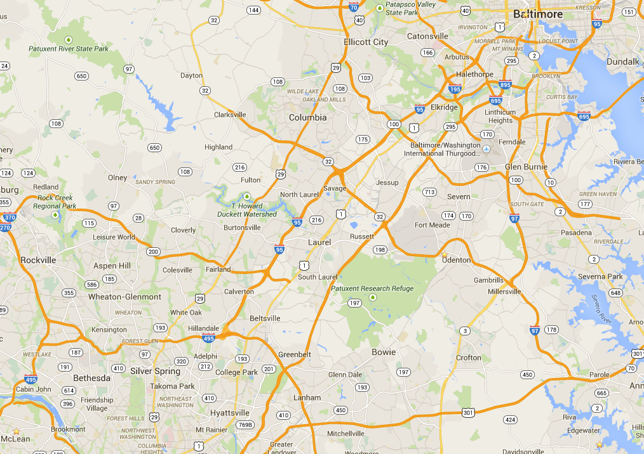
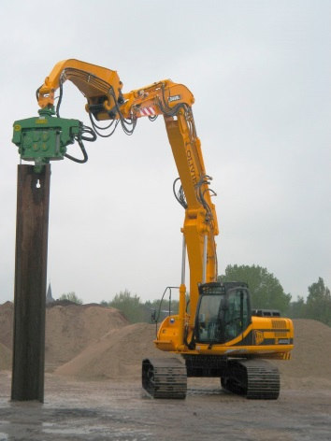
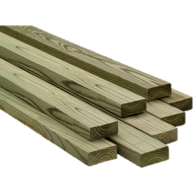
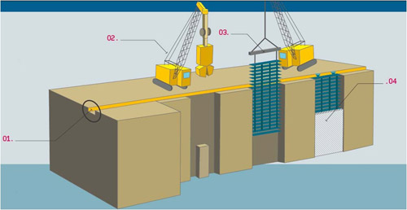
http://www.directindustry.com/prod/international-construction-equipment-bv/pile-driving-vibrator-hydraulic-64206-431915.html
http://www.lowes.com/pd_46905-432-TC248T225N_0__?productId=3185207
Comparison Matrix
Pile and Lagging
Sheet Piles
|Constructability
18.3 miles
45.8 miles
|Availability
Slurry Wall
31.0 miles
http://www.omranista.com/eng/tech5.php

Slide 39
Literature Review
|Maslow’s Hierarchy of Needs
Self-Actualization
Esteem
Physiological
Social
Safety
Inattention to results
Avoidance of accountability
Absence of Trust
Lack of Commitment
Fear of Conflict
|5 Dysfunction of a Team

Slide 40
Survey Results
|Team Performance
To what degree do you think your level of motivation influences your team?
To what degree do you think a motivated leader influences your team performance?
To what degree do you think an unmotivated leader would influence your team performance?
To what degree do you think motivation is directly related to team performance?

Slide 41
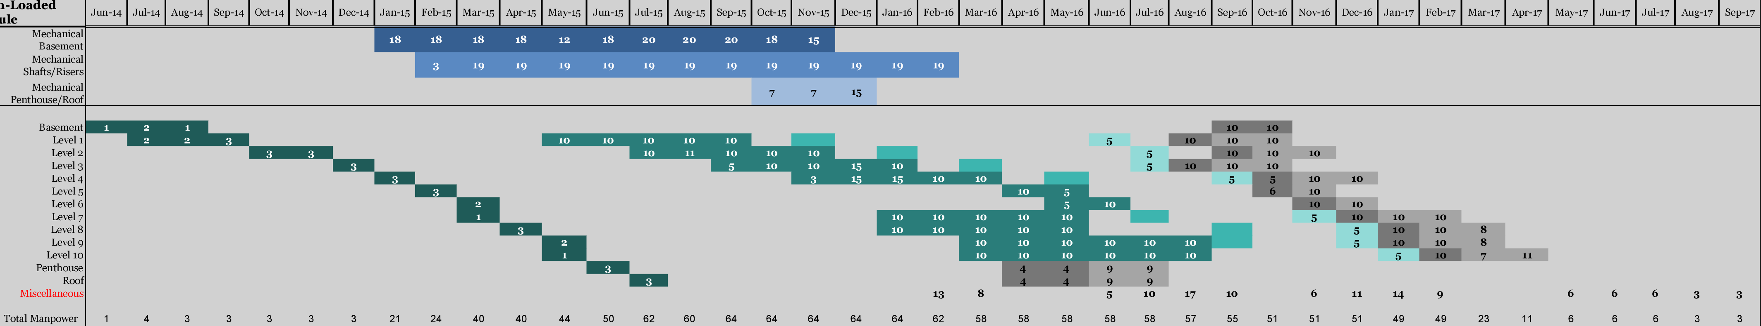
Original Man-loaded Schedule
Legend

